Slide 1
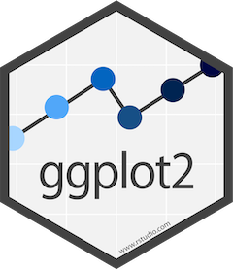
Lesson 22: Data Visualization I
SE370 – Computer-Aided Systems Engineering
MAJ Jae Kim DSE- Instructor

Slide 2
Today
Lesson 22: Data Visualization I
  1. Visualize and summarize data using ggplot2 for data exploration (or hypothesis generation)
  2. Understand and apply facets and aesthetics
  3. Use different geometric objects ("geoms") to represent data
2

Slide 3
Next Time
Lesson 23: Data Visualization II
  "1. Create scatterplots, bar charts, and boxplots using ggplot2
  2. Produce a journal quality graph/plot
  3. Arrange and export plots in high resolution"
3

